Slide 1
Disease Prediction using Support Vector Machine
Momelezi Dlavu

Slide 2
Today’s Agenda
Problem
Process
Insights
Results
Summary

Slide 3
Problem
Misclassification of diseased as healthy leading to an increase in fatality due to unattended diseases
The diagnosis of a patient is time sensitive so, fast and reliable tools to diagnose patients is in demand
Lack of qualified Medical Doctors to correctly diagnose patients at a faster rate

Slide 4
Process
Data Understanding
Data Cleaning
Data Analysis
Model Implementation
Model Evaluation

Slide 5
Insights

Slide 6
Insights

Slide 7
Insights

Slide 8
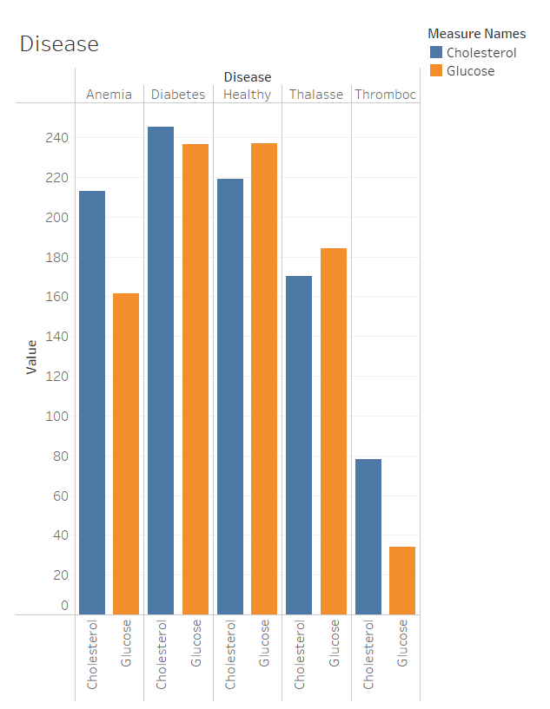
Insights

Slide 9
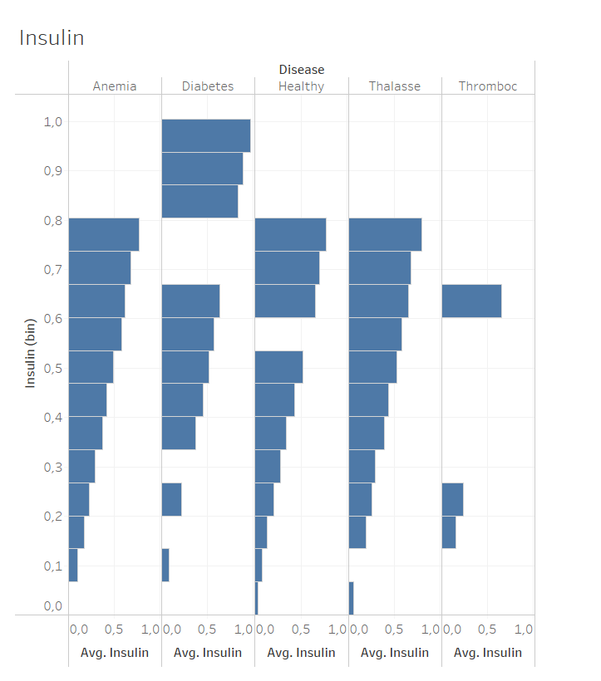
Insights

Slide 10

Results

Slide 11
Results
Tuned SVM
Cost | Kernel | Degree | Gamma
0.001 | Polynomial | 2 | 1
Confusion Matrix
 | Diseased | Not Diseased
Diseased | 342 | 139
Not Diseased | 4 | 1
Accuracy | 71%
Precision | 99%
Recall | 71%
F1-score | 83%

Slide 12

Summary
From the above results it is visible that the model is so precise in predicting patients who have diseases. That helps healthcare institutions to have less fatalities as they know which patients to attend.
The slightly high misclassification of healthy people as not healthy does not put patients in absolute danger, but rather increase their stress levels. So that prompts healthcare facilities to provide counselling to people diagnosed as diseased so to mitigate this misclassification.
Future projects lies on collecting more data of healthy people so that the machine learning models that will be employed in this prediction case can have more data of healthy people to train with.

Slide 13

Thank you!!!
Any questions?

